Slide 1



Constructing Anomaly Detection Model for Time Series Data and Empirical Study
Committee：Jacky Blue Ph.D., Yi-Chun Chen Ph.D., Tzu-Yen Hong Ph.D., Chia-Yu Hsu Ph.D.
Student：Jia-Zhen Zhuang
Department of Industrial Engineering and Management
National Taipei University of Technology
July 21st, 2023

Slide 2
01
Introduction
02
Literature review
Content
03
Proposed method
04
Empirical study
05
Future work

Slide 3





Background
Introduction
Literature Review
Proposed Methods
Empirical Study
Conclusion
Time series is a series of data points arranged in order by time. The purpose of time series anomaly detection is to identify anomalous samples within these sequential data points that different from the normal patterns
In the industrial, the series data will be collected from the machines by the sensors and monitor whether there are any unexpected data performance
3
Notes:
時間序列之異常偵測在於分辨出與正常資料表現不同的資料表現 在工業上會透過感測元件從機台上蒐集訊號資料以此監控是否有異常之發生

Slide 4
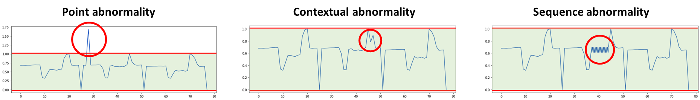
Introduction
Literature Review
Proposed Methods
Empirical Study
Conclusion
Motivation & Research aims
Abnormal samples are rare and the cost of collecting abnormality is expensive
There are different types of time series anomalies
Situation
Choi et al., 2021; Blázquez-García, A et al
Unsupervised learning is performed through the structure of data
Labeled abnormal samples are rare or simply do not exist
Challenge
A single anomaly detection method may not be significant for all types of anomalies
The problem of algorithm generalization.
Research aims
An unsupervised framework which can detect different type of time series abnormal
Using data generation as data augmentation to improve generalization ability
4
Notes:
在異常偵測任務中，蒐集異常樣本的成本昂貴，因此在實際狀況中，異常樣本數量稀少 在時間序列異常上也有許多種類，透過單一的異常偵測方法也無法在所有種類上具有顯著性 因此希望提出能夠偵測多個異常種類的非監督式異常偵測框架 同時為了增加方法的泛化性，使用資料生成的方式進行資料增強

Slide 5
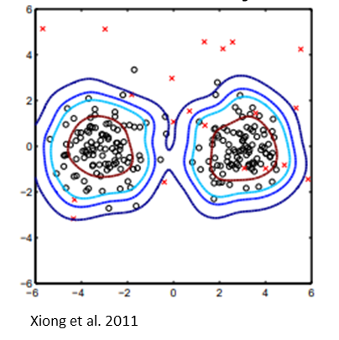
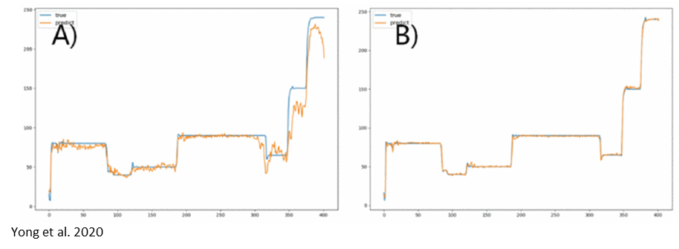
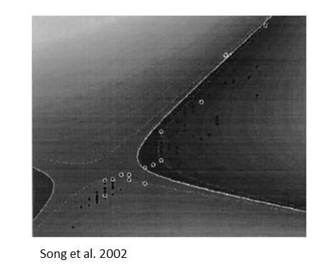
Introduction
Literature Review
Proposed Methods
Empirical Study
Conclusion
Unsupervised Anomaly Detection
Base on Reconstruction
One-class Classification
Cluster Analysis
Assumed abnormal samples are not easily compressible, so it can not reconstruct from the low-dimensional space.
Issue : Some abnormal samples have the same level of the thresh hold as normal samples.
Dividing data into several groups by distance or similarity.
Issue : Dimensionality reduction and cluster analysis are independent of each other, it may lost key information of abnormal data.
Learning discriminant boundaries around normal samples.
Issue : Due to the curse of dimensionality, the methods often give suboptimal results.
Zong et al. 2018
This study use DAGMM as the anomaly detection model architecture which is :
End to end deep learning model
Joint optimization of dimension reduction and clustering.
5
Notes:
非監督式異常偵測的方法有單標籤分類、聚類以及基於重構的異常偵測方法
基於重構的方法是透過學習資料特徵並重建，去計算輸入與重建資料之相似度 單標籤和聚類方法是透過資料性質去進行正常與異常的劃分 而這兩類方法在處理較複雜的資料時會先進行降維在執行聚類，但這兩個獨立的步驟會造成次優的結果 因此本研究使用在2018年所提出的DAGMM模型，DAGMM是端到端的深度學習模型 其特點是透過深度學習的特性達到降維和密度估計的聯合優化

Slide 6
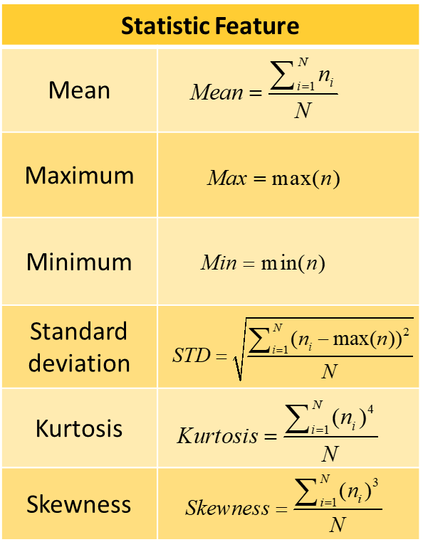
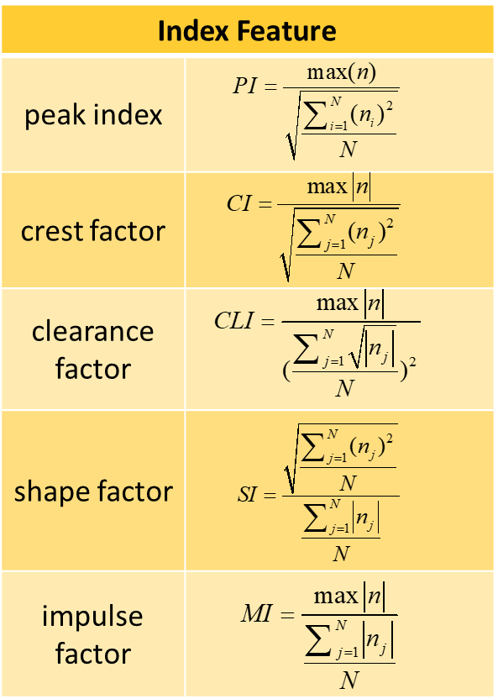
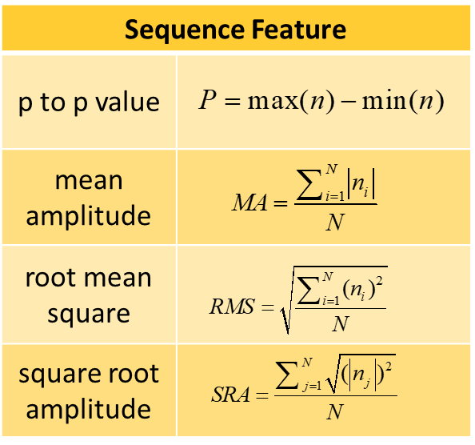
Introduction
Literature Review
Proposed Methods
Empirical Study
Conclusion
Time domain features
Time-domain features are used to describe the statistical properties and temporal structure of signals data, and these features are directly extracted from the series data
In the selection of features, we choose the features which focus on the size of change in series
6
Notes:
時域特徵分析在時間序列異常偵測中，也是常用的方法 時域特徵能夠描述序列的統計特徵以及時間上的結構 本研究在特徵的選用上使用著重在表現序列變化幅度的特徵

Slide 7
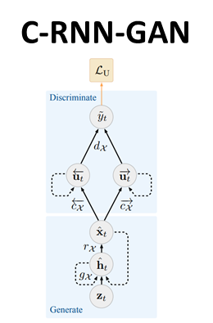
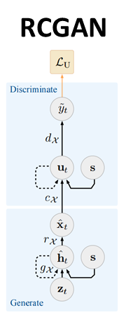
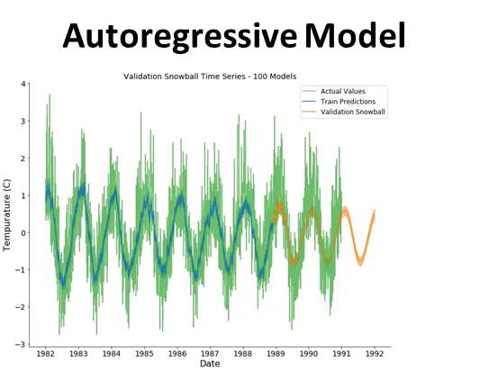
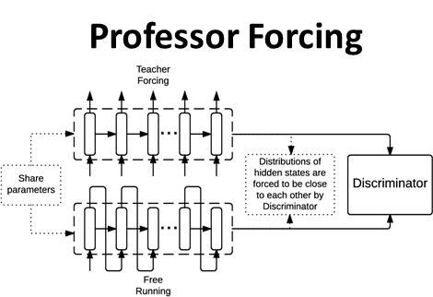
Introduction
Literature Review
Proposed Methods
Empirical Study
Conclusion
Time Series Generation
Sequence Generation
Temporal Dynamic
Using the framework of GAN, the noise and the data generated in the previous time step are used as input to generate data.
Issue : Relying on binary adversarial feedback, can not guarantee networks can capture temporal dynamics.
Generate output by forecasting or blending previously generated data with actual data.
Issue : Deterministic output, unable to learn sample distribution.
Yoon et al. 2019
This study use TimeGAN as the generation model which ensure model can capture the information below :
statistical properties
long-term dependencies
dynamic temporal relationships
7
Notes:
在時間序列的生成上，自回歸或是Professor forcing無法學習資料的特徵分布 而近年來使用gan架構的生成方式效果不錯，但模型在生成上沒有考慮到動態時間關係 因此本研究使用在2019年由學者提出的timegan來做為生成模型 timegan的優勢在於能夠學習資料的靜態統計分布、長時間的依賴關係以及動態時間關係

Slide 8
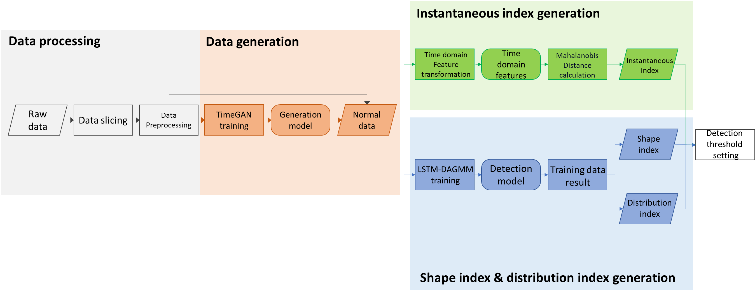
Introduction
Literature Review
Proposed Methods
Empirical Study
Conclusion
Propose Method – training stage
8

Slide 9
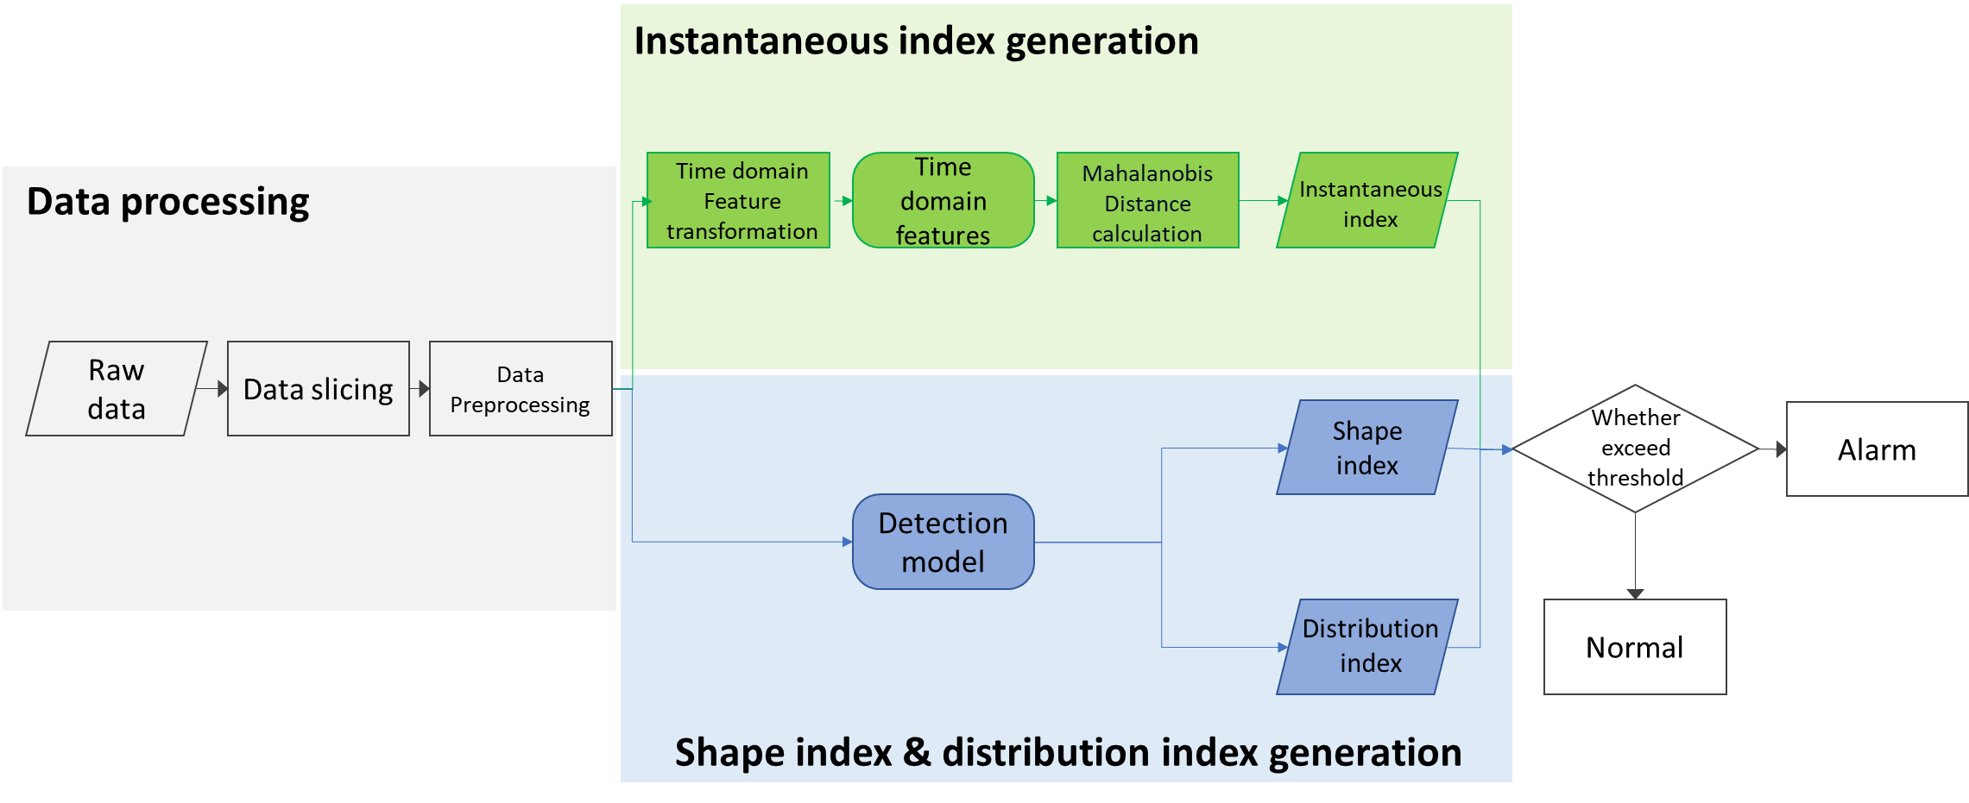
Introduction
Literature Review
Proposed Methods
Empirical Study
Conclusion
Propose Method – inference stage
9

Slide 10
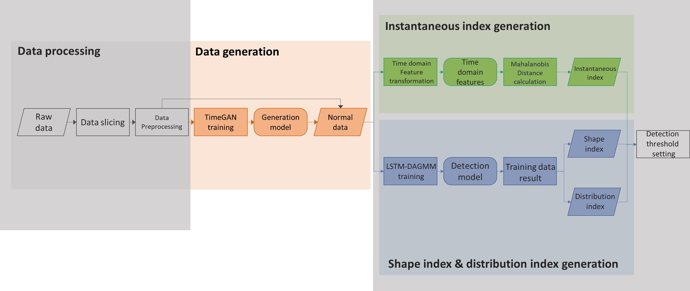
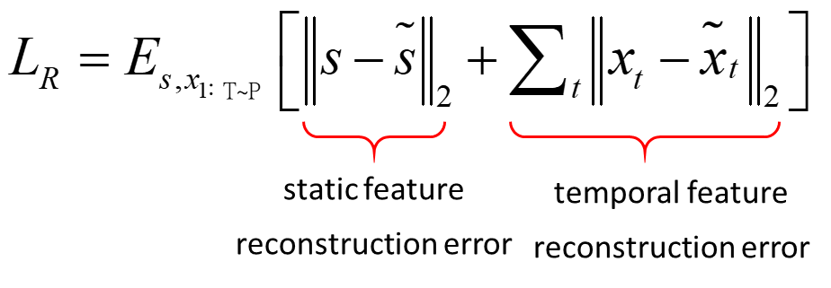
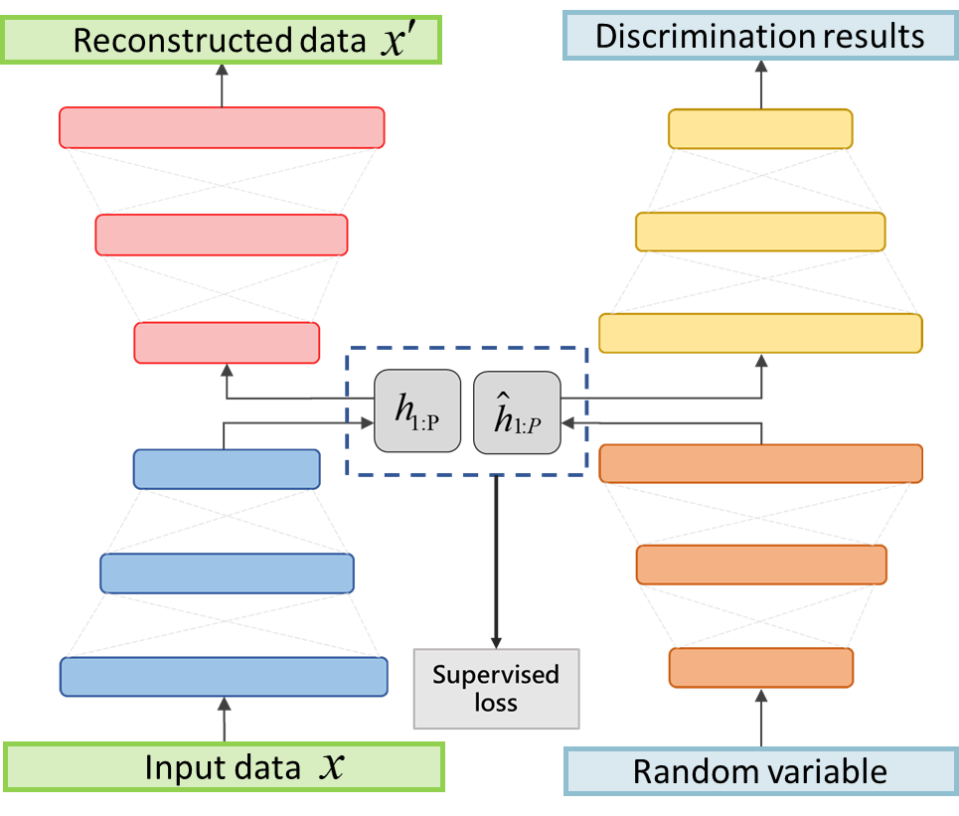
Introduction
Literature Review
Proposed Methods
Empirical Study
Conclusion
Data Generation - Time-Series GAN
Reconstructed loss
Encoding learning
(Yoon et al. 2019)
Step 1.
Autoencoder component training
Recovery network
Discriminant network
Unsupervised loss
Data generation
Step 2.
adversarial generation component training
Embedding network
Generate
network
Supervised loss
Step 3.
Joint learning
10

Slide 11
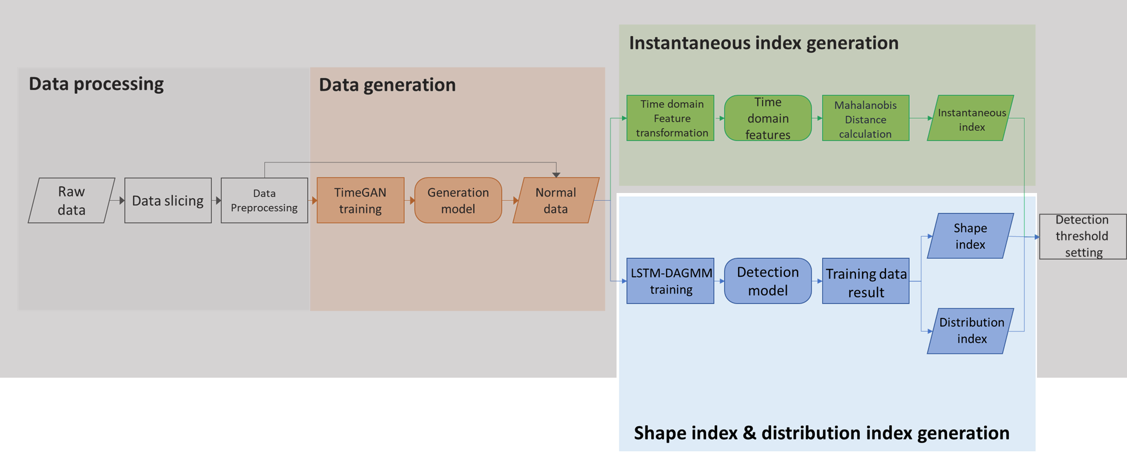
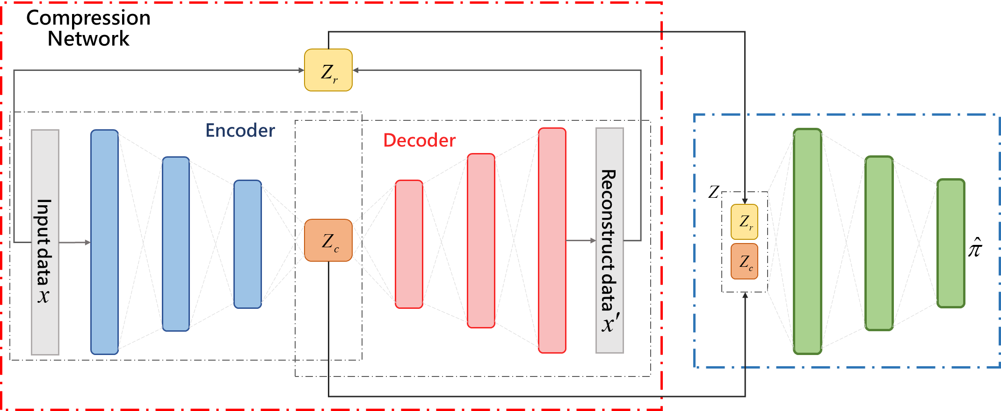
Introduction
Literature Review
Proposed Methods
Empirical Study
Conclusion
Anomaly Detection - DAGMM
( Zong et al. 2018)
Compression network
Dimensionality reduction and low-dimensional feature space construction.
Output：sequence similarity and latent space feature
Where sequence similarities are :
Estimation network
Density estimation via reconstruction error and low-dimensional features
Output：Mixed composition
DAGMM optimizes the learning of dimensionality reduction and density estimation at the same time by joint training.
11

Slide 12
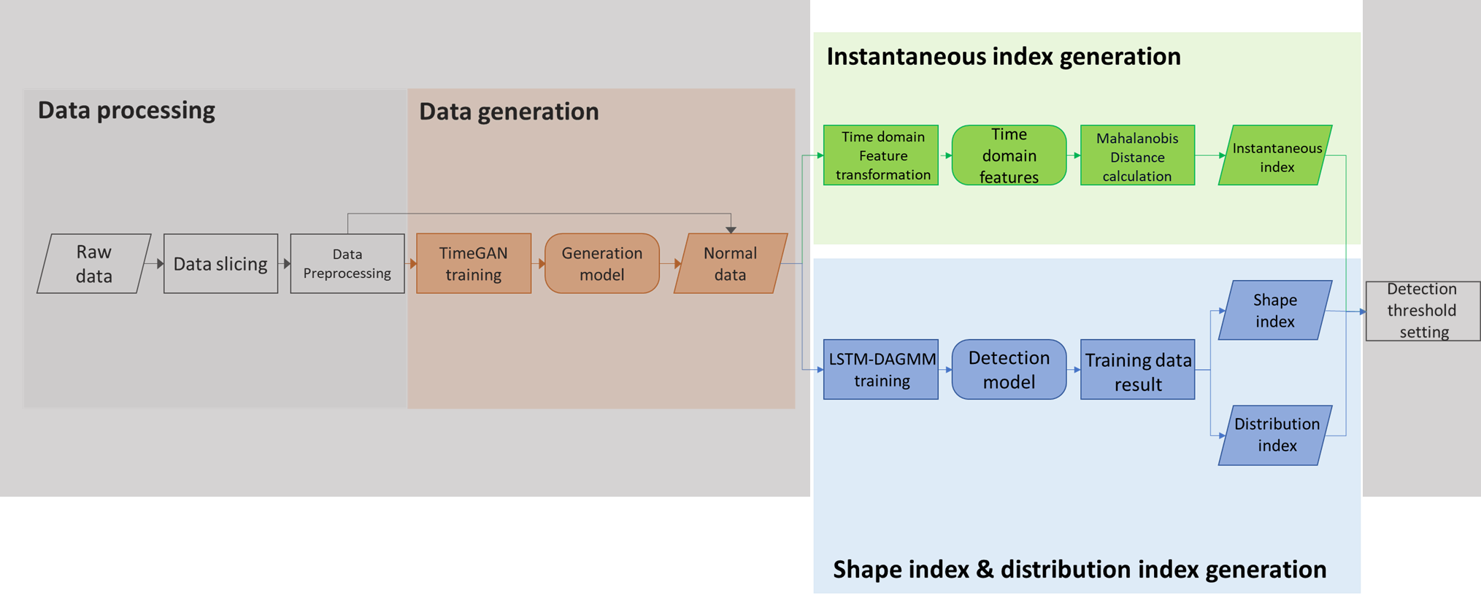
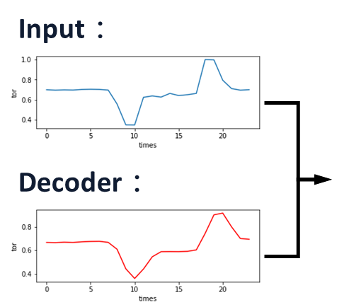
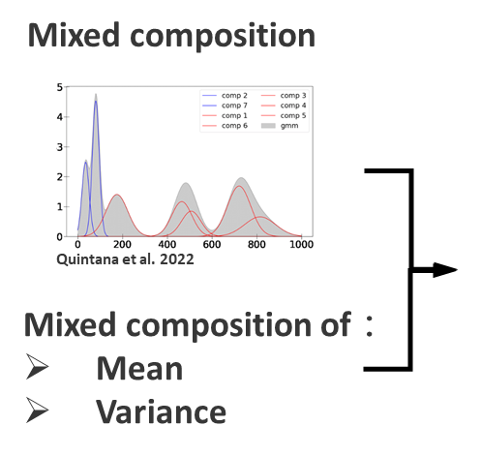
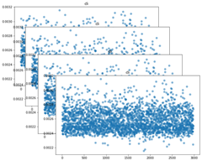
Introduction
Literature Review
Proposed Methods
Empirical Study
Conclusion
Monitor strategy
Shape indicator：
Determine if the samples exhibit unexpected performance in the original space by MSE .
( Compression network )
Estimation network
Distribution indicator：
The calculation of the NLL. A higher value indicates a poorer match with the model.
( Estimation network )
Instantaneous indicator：
Obtaining by Mahalanobis distance and time-domain features, determine small and short changes in series.
( Time domain features similarity)
Time domain feature
12

Slide 13
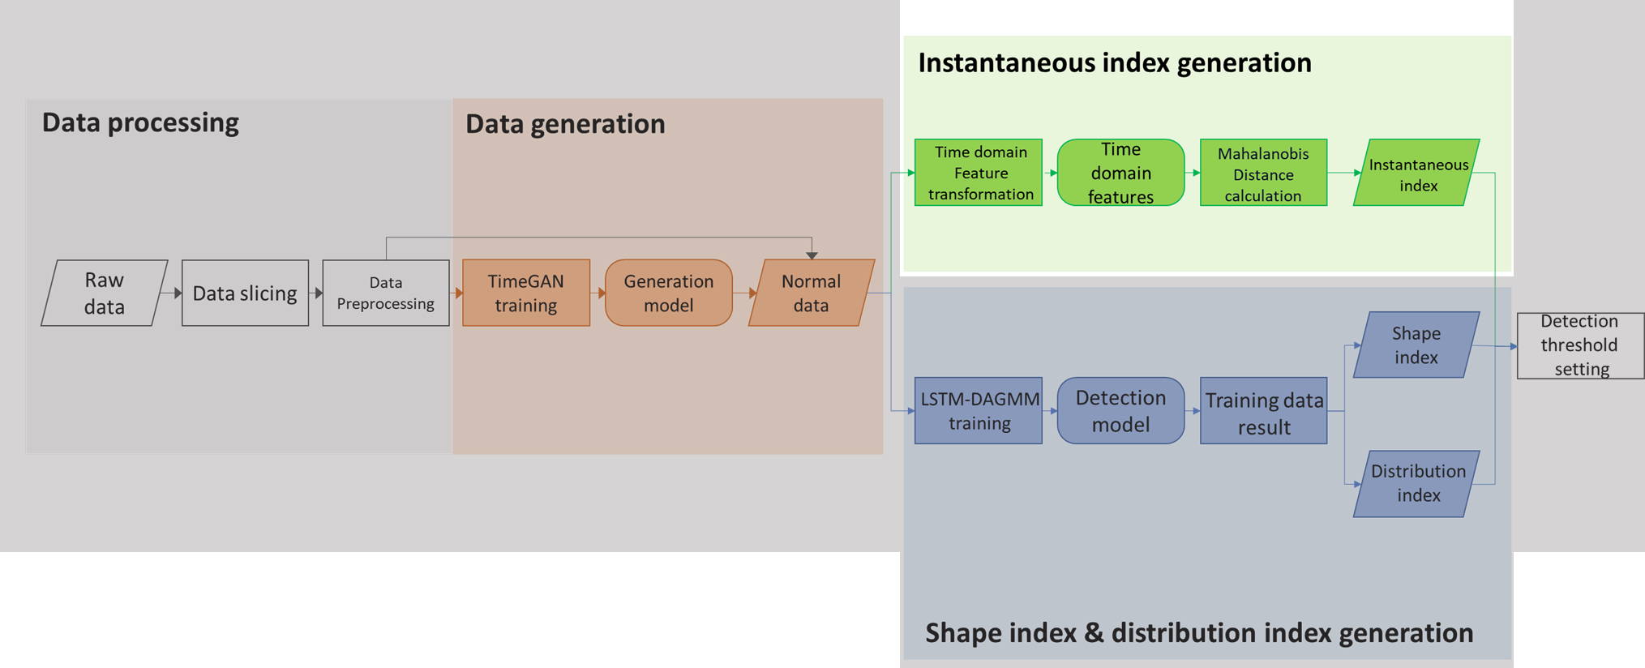
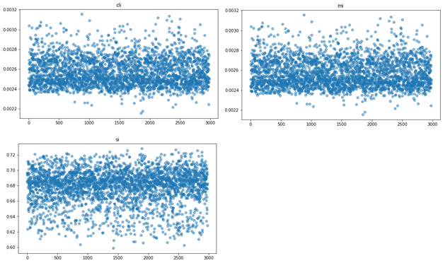
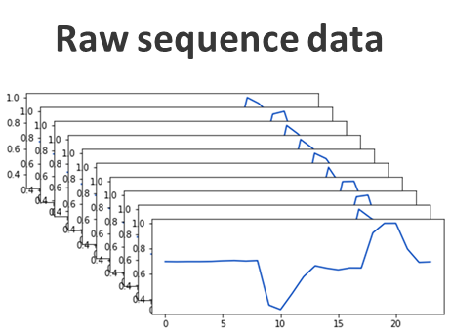
Introduction
Literature Review
Proposed Methods
Empirical Study
Conclusion
Monitor strategy - instantaneous indicator
Time domain feature transformation
Statistic feature | Maximum
 | Minimum
 | Standard deviation
Sequence feature | p to p value
 | peak index
 | crest factor
 | clearance factor
 | shape factor
 | impulse factor
Set mean as central by feature
Time domain feature
……
……
Mahalanobis distance calculation
Instantaneous indicator

Slide 14
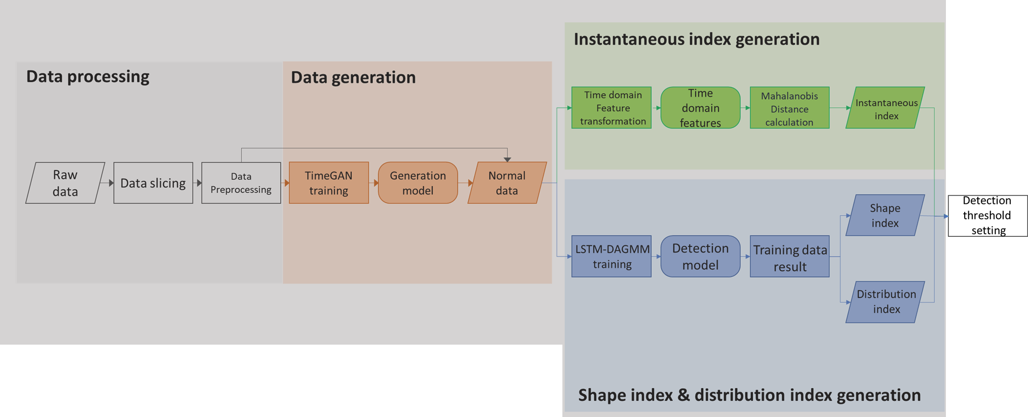
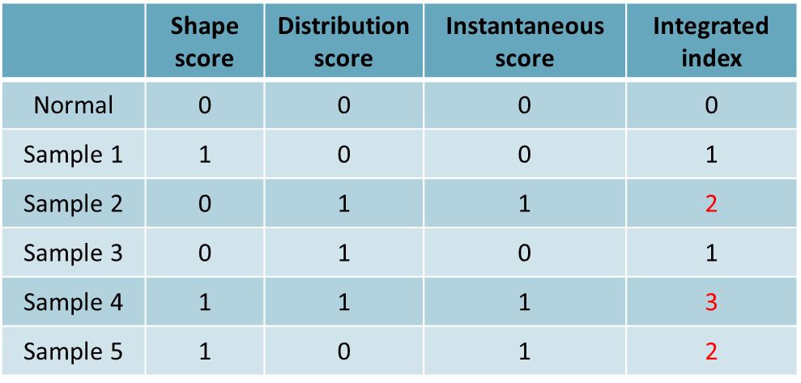
Introduction
Literature Review
Proposed Methods
Empirical Study
Conclusion
Monitor strategy – integrated index
Where :
For each indicator :
If indicator exceed threshold → indicator score = 1
For example :
Shape indicator：
If shape indicator exceed threshold → Shape score = 1
Else shape score =0
After score transformation, each indicator score will be concatenate as state array

Slide 15
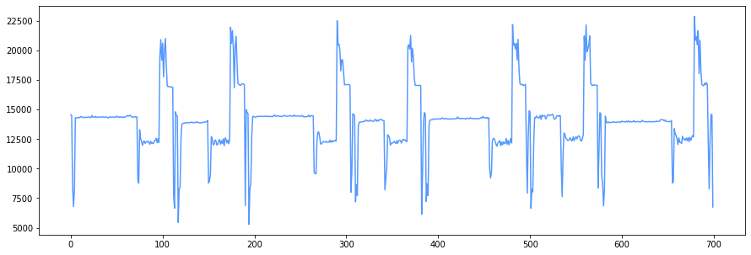


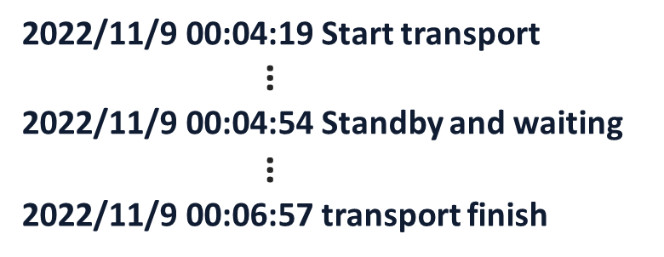
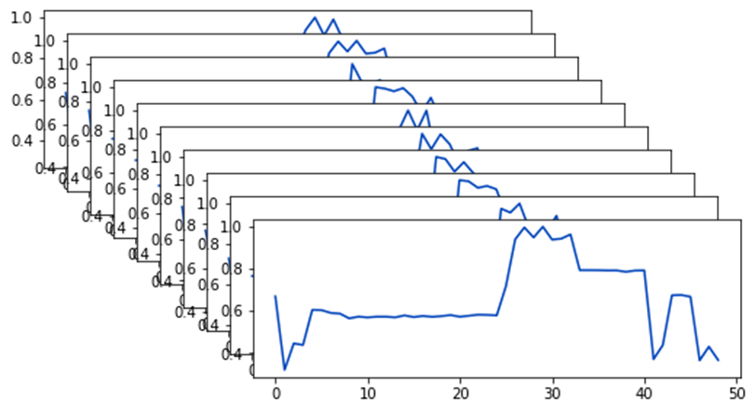
Introduction
Literature Review
Proposed Methods
Empirical Study
Conclusion
Data description
By robot operating cycle
 | TimeGAN | LSTM-DAGMM
Training set | 2979 | 5958 | 2979(real data)
 |  |  | 2979(TimeGAN)
Validation set | - | 566
Test set | - | 704
Sequence length | 26 | 26
Torque sequence data
……
15

Slide 16
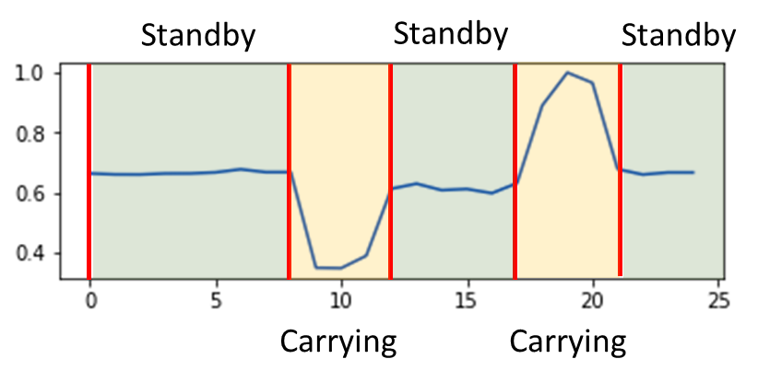
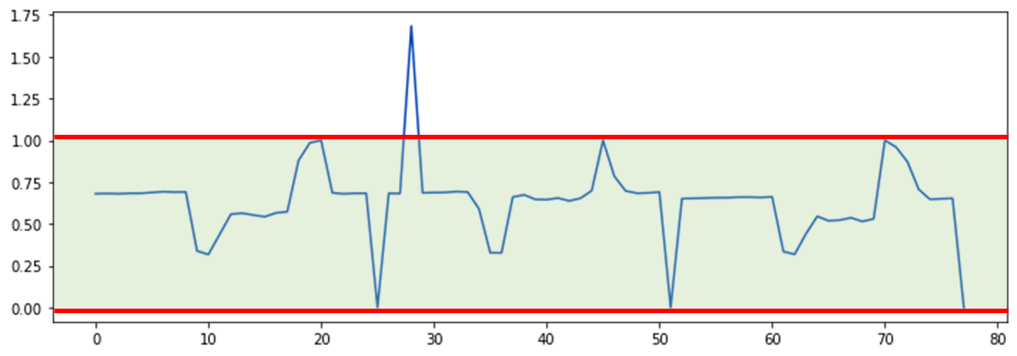
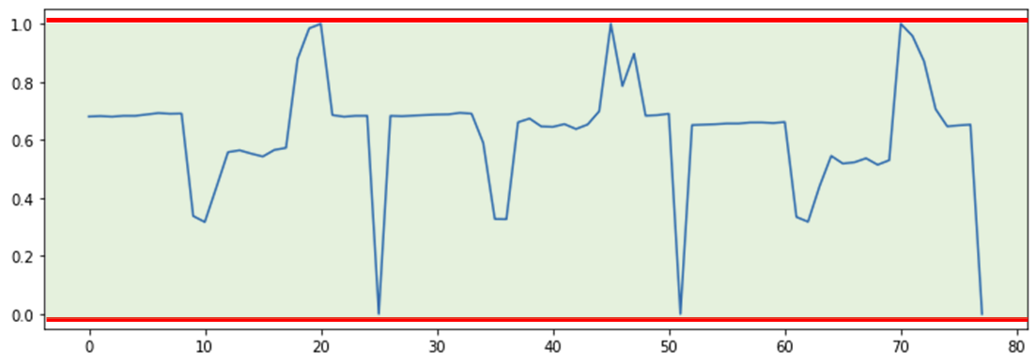
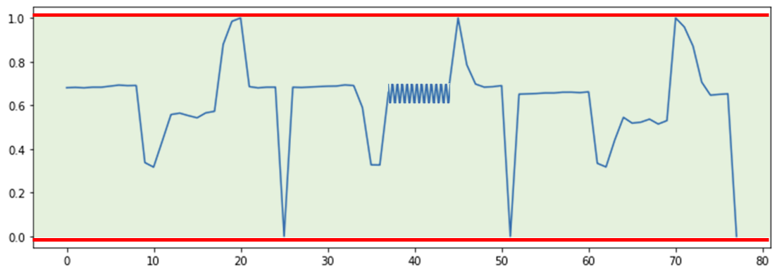
Introduction
Literature Review
Proposed Methods
Empirical Study
Conclusion
Experiment design
Point abnormality
Operation | factor
Standby | Belt
Carrying | Bearing Slider
Complexity | Belt & bearing Belt & slider
Contextual abnormality
Based on the machine‘s operating principles and combined with normal signal data, design abnormal samples corresponding to the following types of anomalies：
Contextual abnormality
point abnormality
sequence abnormality
Sequence abnormality
16
Notes:
點異常代表突發且劇烈的異常表現 上下文異常代表在時間上出現不正確的表現 序列異常代表在短時間內不易被觀察出的異常

Slide 17
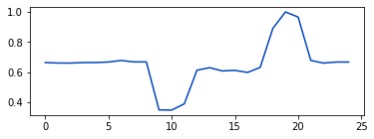
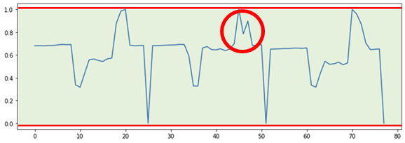
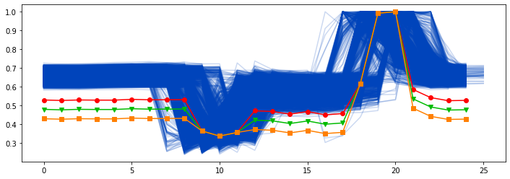
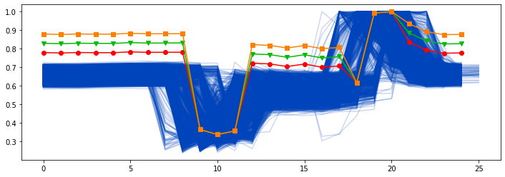
Introduction
Literature Review
Proposed Methods
Empirical Study
Conclusion
Experiment design - Standby section abnormality
Standby
Standby
Standby
Standby section abnormality can be determined as Contextual abnormality
Loose belt
tightened belt
17

Slide 18
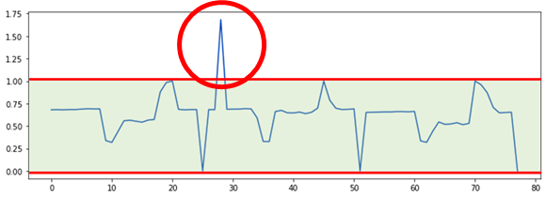
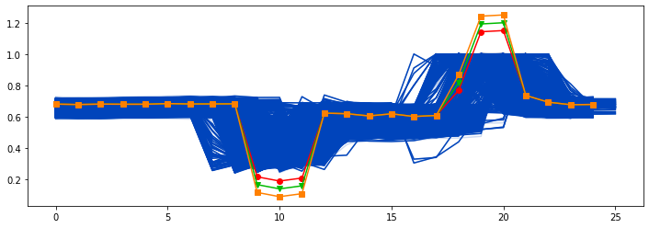
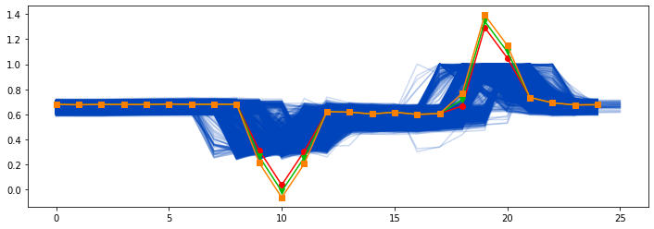
Introduction
Literature Review
Proposed Methods
Empirical Study
Conclusion
Experiment design - Carry section abnormality
Carry section abnormality can be determined as point abnormality
Sequence design：slider
Point design：bearing
Carrying
Carrying
Slider loose
Bearing loss
18

Slide 19
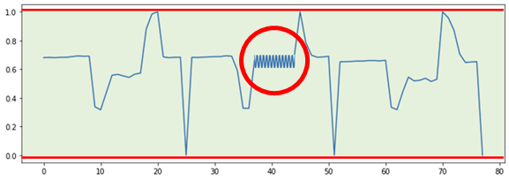
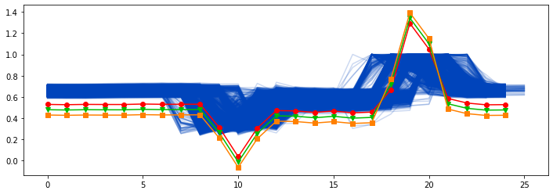
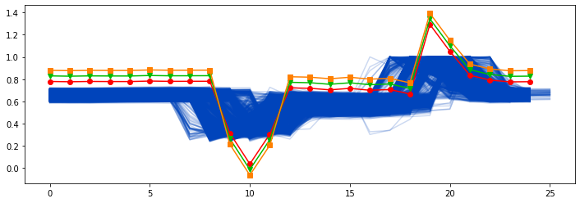
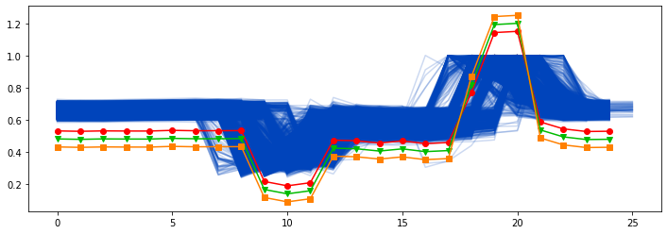
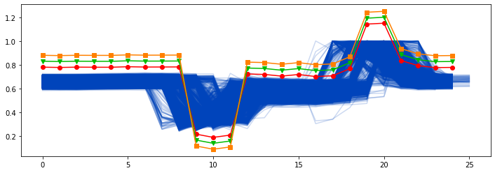
Introduction
Literature Review
Proposed Methods
Empirical Study
Conclusion
Experiment design - Complexity abnormality
Complexity abnormality can be determined as sequence abnormality
Loose belt & Bearing loss
tightened belt & Bearing loss
Loose belt & Slider loose
tightened belt & Slider loose
19

Slide 20
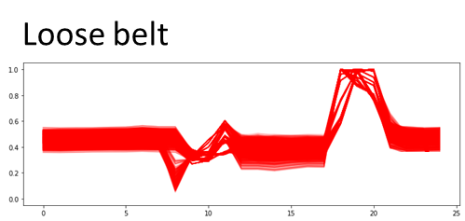
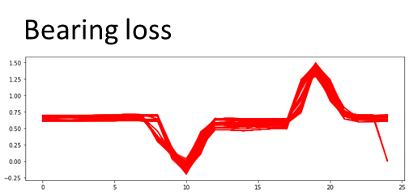
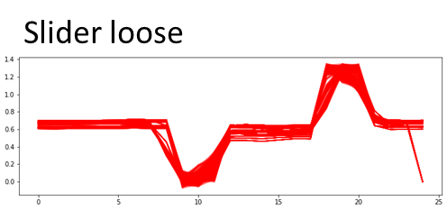
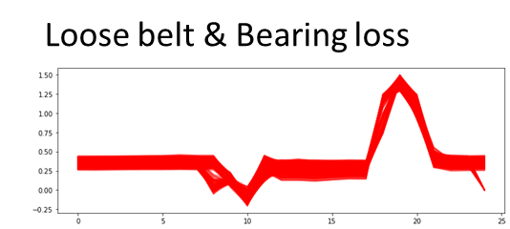

Introduction
Literature Review
Proposed Methods
Empirical Study
Conclusion
Test data setting
Testing set :
No. Normal data : 704
No. abnormal data :
 |  | prediction
 |  | Abnormal | normal
True | Abnormal | TP | FN
 | normal | FP | TN
Generate 1000 records for each type of anomaly based on their degree of severity.
Repeat the testing process 10 times and average the results for evaluation.
Sample type
Normal | 704
Abnormal (total 8 type) | 100(each type)
Total No. sample | 1504
Each indicator use the 95th percentile of the training set results and fine-tuned with the validation
Integrated index threshold setting is 1
20

Slide 21






Introduction
Literature Review
Proposed Methods
Empirical Study
Conclusion
Mixed data training result
Shape index result in Real data
Shape index result in mixed
t-SNE result
Distribution index result in Real data
Distribution index result in Mixed
False Negative(FN) result in mixed data
Mixed training improves the detection of samples on the decision boundary
Enhances the data profile of normal samples
Optimizes the detection of anomalous samples near the boundary.
21

Slide 22

Introduction
Literature Review
Proposed Methods
Empirical Study
Conclusion
Validity
For two samples with the contextual abnormality, the shape of tightened belt is more similar to the normal sample. As a result, it effects the detection capability
performance metrics : Recall
 | shape | distribution | instant
Loose belt | 0.9277 | 1.0000 | 1.0000
tightened belt | 0.6071 | 0.9111 | 0.9958
Bearing loss | 0.6236 | 0.2027 | 1.0000
Slider loose | 0.5208 | 0.0625 | 1.0000
Loose belt & Bearing loss | 0.9000 | 0.9902 | 1.0000
Loose belt & Slider loose | 1.0000 | 1.0000 | 1.0000
tightened belt & Bearing loss | 0.9944 | 0.5750 | 1.0000
tightened belt & Slider loose | 0.9986 | 0.2986 | 0.9541
Loose belt
tightened belt
For point anomalies, which involve short and rapid changes, shape indicators have similar performance with the normal samples
22

Slide 23

Introduction
Literature Review
Proposed Methods
Empirical Study
Conclusion
Validity
The distribution indicator is a model's measure of the latent representation of a sample in terms of its distribution, which involves observing the overall characteristics of the sequence. point anomalies have a less significant effect on the overall characteristics, making the distribution indicator less capable of detecting point anomalies effectively.
performance metrics : Recall
 | shape | distribution | instant
Loose belt | 0.9277 | 1.0000 | 1.0000
tightened belt | 0.6071 | 0.9111 | 0.9958
Bearing loss | 0.6236 | 0.2027 | 1.0000
Slider loose | 0.5208 | 0.0625 | 1.0000
Loose belt & Bearing loss | 0.9000 | 0.9902 | 1.0000
Loose belt & Slider loose | 1.0000 | 1.0000 | 1.0000
tightened belt & Bearing loss | 0.9944 | 0.5750 | 1.0000
tightened belt & Slider loose | 0.9986 | 0.2986 | 0.9541
In the case of complexity anomalies, the detection performance is poorer for the tightened belt type of complexity anomalies. This may be due to that in this type of combination, the anomalies exhibit abnormal numerical values, but from a distributional perspective, they appear similar to normal samples.
23

Slide 24

Introduction
Literature Review
Proposed Methods
Empirical Study
Conclusion
Validity
performance metrics : Recall
 | shape | distribution | instant
Loose belt | 0.9277 | 1.0000 | 1.0000
tightened belt | 0.6071 | 0.9111 | 0.9958
Bearing loss | 0.6236 | 0.2027 | 1.0000
Slider loose | 0.5208 | 0.0625 | 1.0000
Loose belt & Bearing loss | 0.9000 | 0.9902 | 1.0000
Loose belt & Slider loose | 1.0000 | 1.0000 | 1.0000
tightened belt & Bearing loss | 0.9944 | 0.5750 | 1.0000
tightened belt & Slider loose | 0.9986 | 0.2986 | 0.9541
The instantaneous indicator performs best among the three indicators, with a slight decrease for tightened belts and belt-slider anomalies. This may be because these two anomalies exhibit peak variations that are similar to normal samples.
24

Slide 25


Introduction
Literature Review
Proposed Methods
Empirical Study
Conclusion
Anomaly detection result - comparison
The proposed method has high accuracy, and the capability of capturing anomalies is significant, and also has the most balanced performance.
The reconstruction-based autoencoders also showed good results, but its anomaly detection performance significantly differed from the proposed method.
The other methods, such as k-means based on DTW and the two-step GMM, had the best recall and precision. However, other metrics indicate that these methods might have higher false negatives and false positives.
25

Slide 26

Introduction
Literature Review
Proposed Methods
Empirical Study
Conclusion
Anomaly detection result - comparison
performance metrics : Recall
Reconstruction based :
Compared to traditional AE, the detection method used is more capable of detecting instantaneous anomalies in abnormal samples.
Time series clustering ：
The detection capability for instantaneous anomalies and complex anomalies is inadequate.
Two step method：
The results obtained from K-means and GMM with two step method indicate that the two-step method has weaker detection capabilities for instantaneous anomalies and complex anomalies.
26

Slide 27
Introduction
Literature Review
Proposed Methods
Empirical Study
Conclusion
Conclusion
Anomaly Detection
In the proposed method, three anomaly detection indicators are utilized to detect anomalies from different aspects, each offering significant advantages over traditional anomaly detection methods. These indicators have their respective strengths:
Shape indicator: part of contextual anomalies and sequence anomalies.
Distribution indicator: contextual anomalies and part of sequence anomalies.
Instantaneous indicator: point anomalies.
Data augmentation
In terms of data augmentation, generating normal state samples and blending synthetic and real normal samples help improve the data distribution of normal state samples for the anomaly detection model. The results show an enhancement in the model's ability to discriminate samples on the decision boundary.
27

Slide 28
THANK YOU

